Slide 1
Realtime hardware control and monitoring
Via Arduino Microcontroller and SIMULINK
Sajid ali
sajidali75092@gmail.com

Slide 2
Introduction
There are three parts of this simulation
Hardware Interface
Control
Monitoring
Arduino microcontroller is used to interface hardware with Simulink

Slide 3
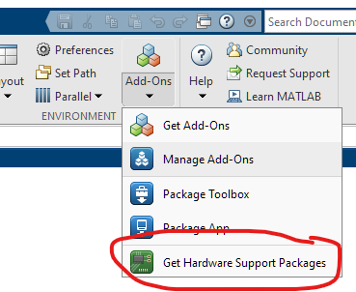
Hardware and software requirements
MATLAB version 2018 or later
Hardware support package for Arduino
This can be downloaded from within MATLAB.

Slide 4
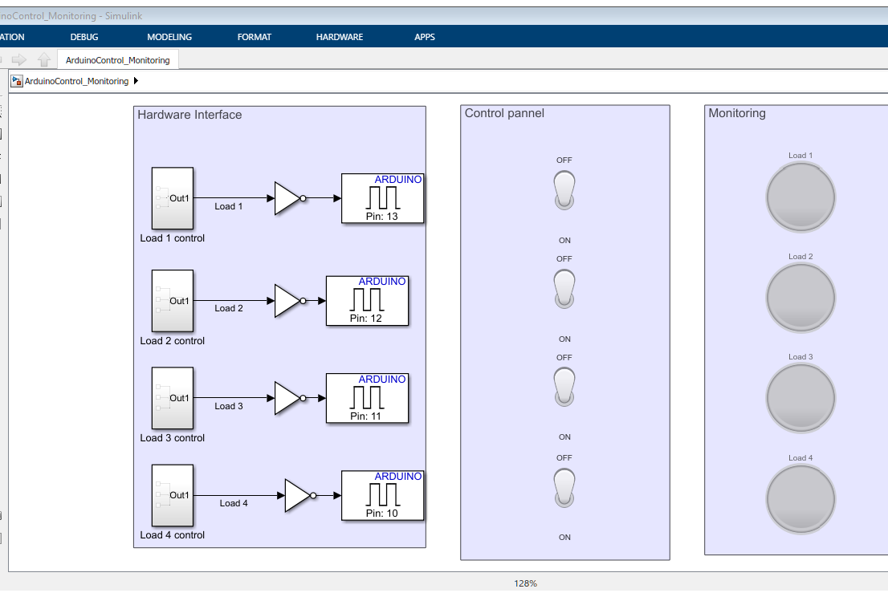
Simulink window

Slide 5
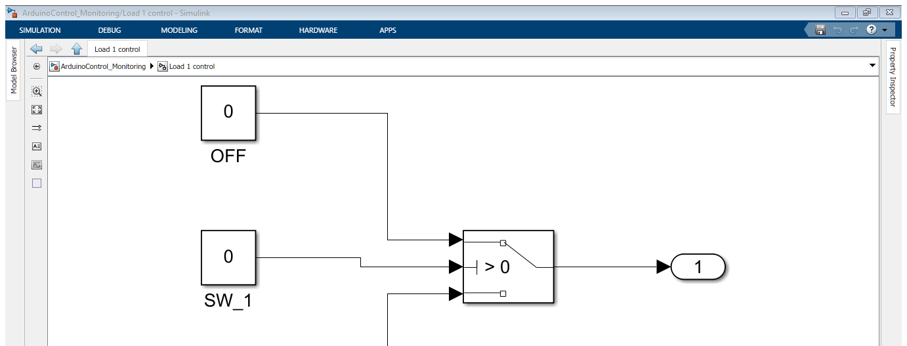
Load Control

Slide 6
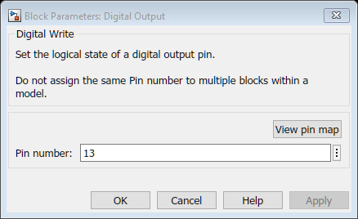
Digital output

Slide 7
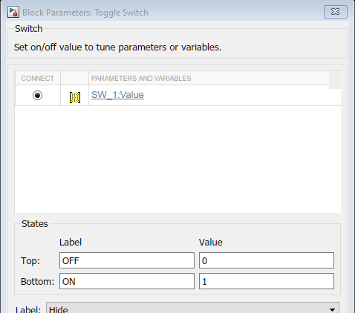
Control panel switch

Slide 8
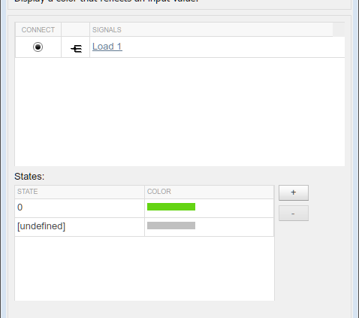
Monitoring Lamp

Slide 9
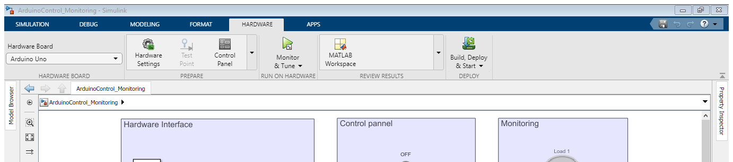










Running sequence
Select the board from the dropdown menu
Connect the hardware
Click on build deploy and start button

